Slide 1


Data
PREPROCESSING
2022
AI IN 5G CHALLENGE
Notes:
Machine Learning 5G

Slide 2

Table of Contents
The Importance of Data Preprocessing
Data Cleaning
Data Transformation
Dimensionality Reduction
Q & A Session
Jupyter Notebooks

Slide 3





Machine Learning Steps
z
Collect data
Data
Preprocessing
Model
Building
Evaluation
Deployment

Slide 4
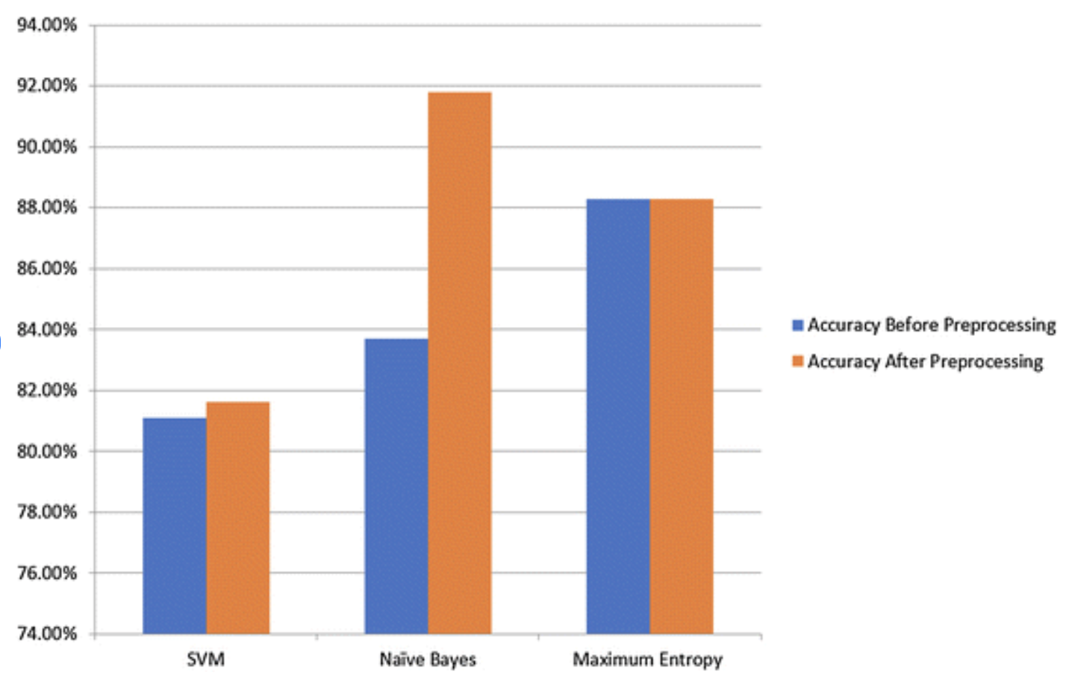
Why pre-process?
Accuracy: To check whether the data entered is correct or not.
Completeness: To check whether the data is available or not recorded.
Consistency: To check whether the same data is kept in all the places that do or do not match.
Timeliness: The data should be updated correctly.
Believability: The data should be trustable.
Interpretability: The understandability of the data.
Alam, Saqib & Yao, Nianmin. (2019). The impact of preprocessing steps on the accuracy of machine learning algorithms in sentiment analysis. Computational and Mathematical Organization Theory. 25. 10.1007/s10588-018-9266-8.

Slide 5
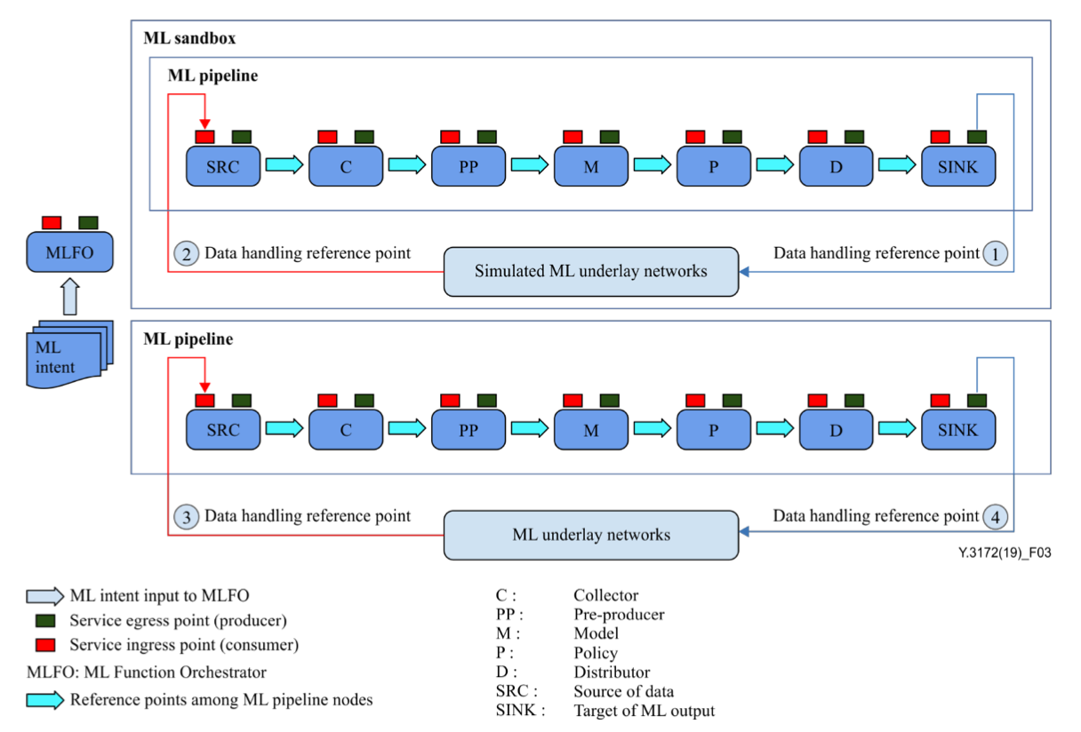
Machine Learning Steps Example in Networks
ITU Recommendation Y.3172

Slide 6
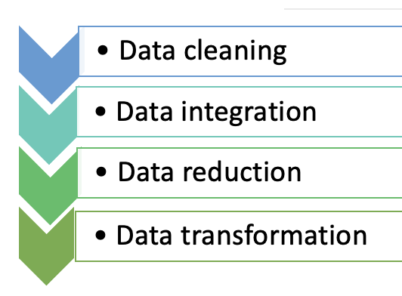
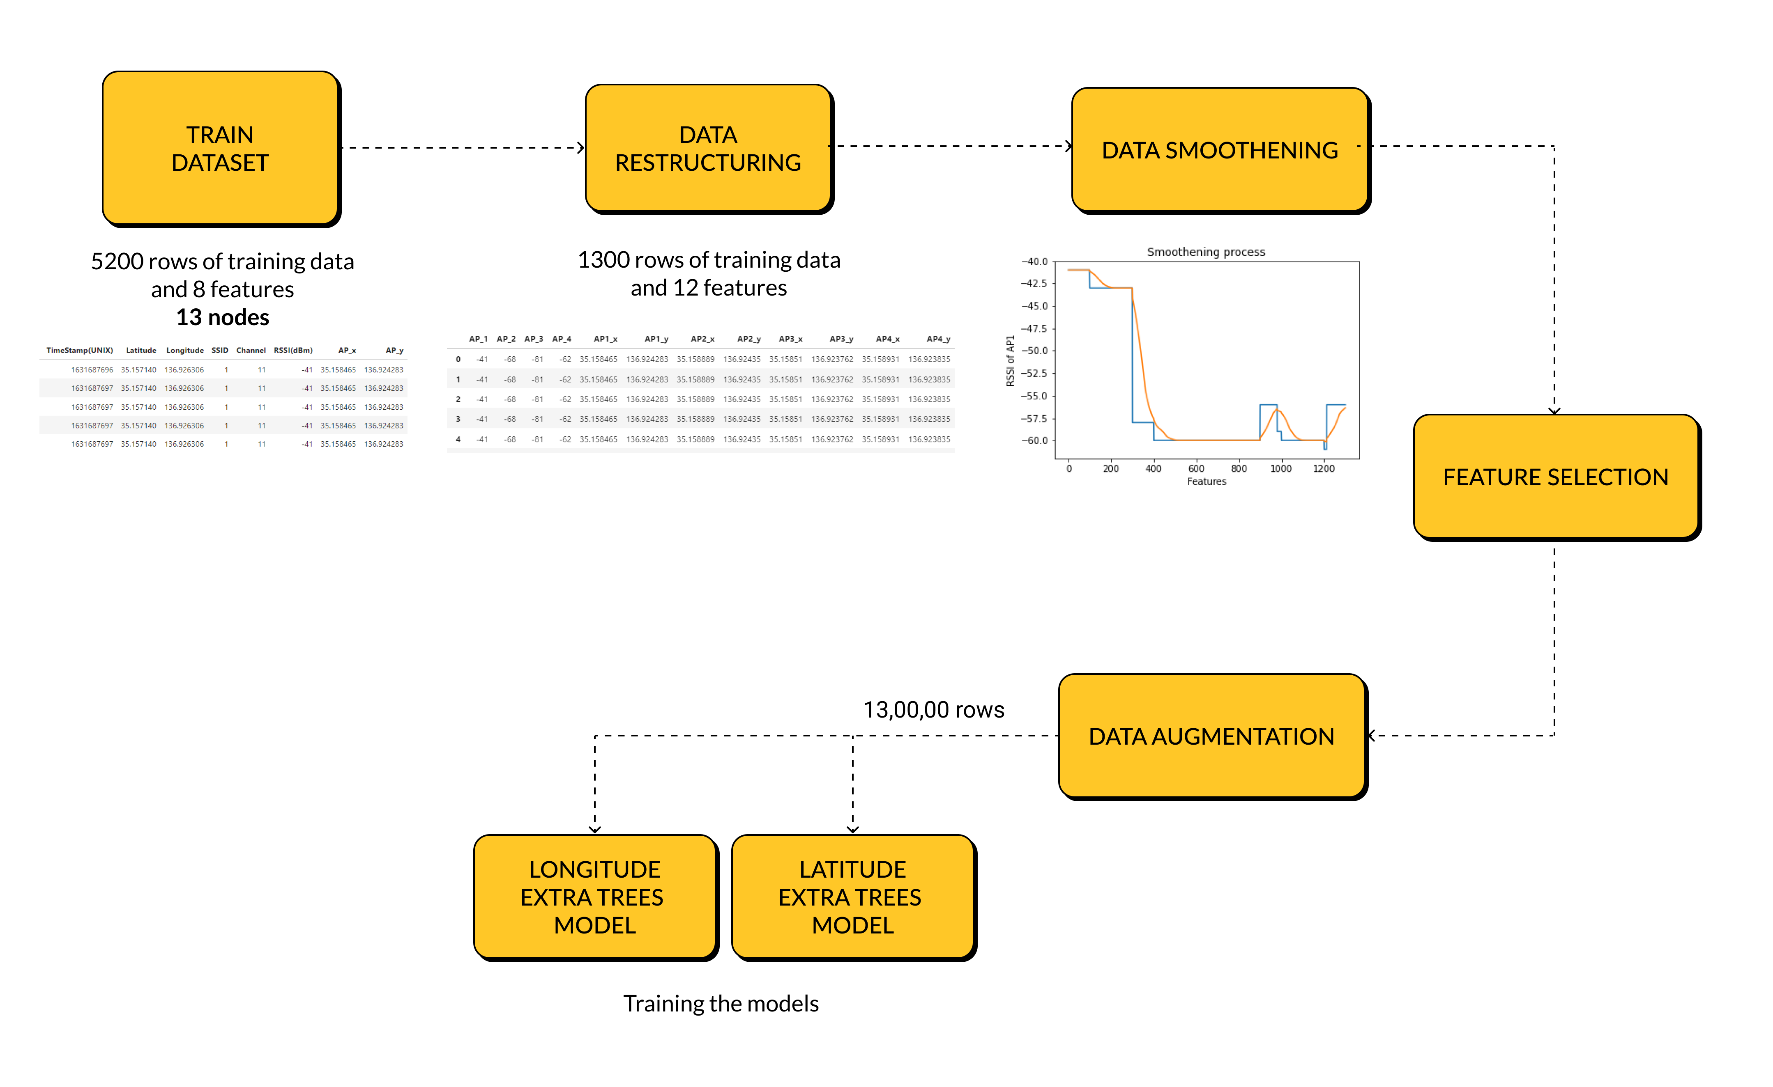
Tasks in Data Preprocessing
Solution and diagram from: SSN_ITU
Github: https://github.com/ITU-AI-ML-in-5G-Challenge/SSN_ITU-ML5G-PS-016

Slide 7
Data Cleaning

Slide 8
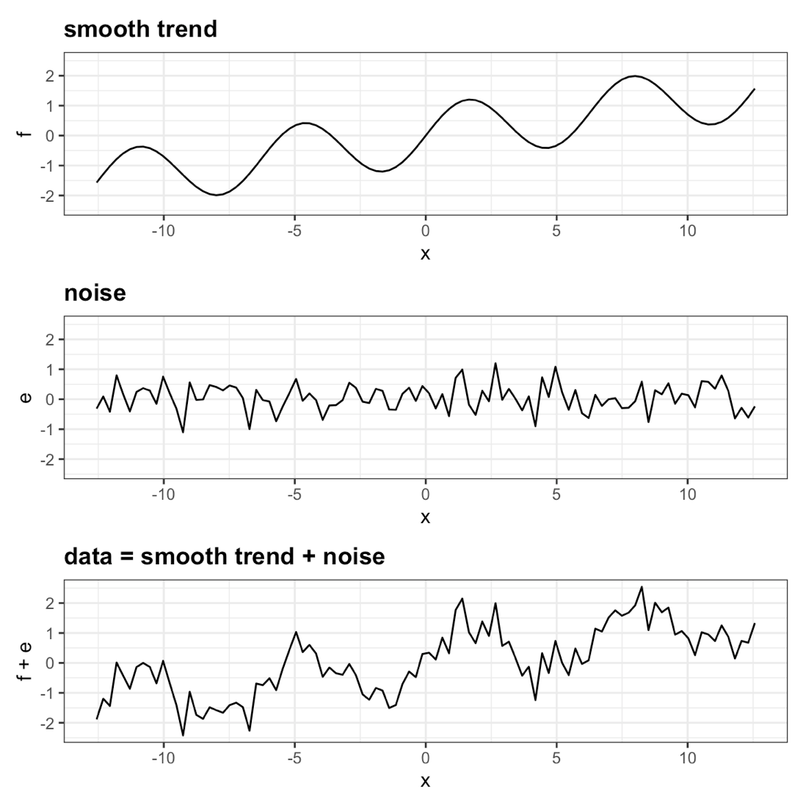
Noisy Data
Participant Number | Age | Height (cm) | Sex
0 | 12 | 130 | F
1 | 51 | -6 | M
2 | 28 | 173 | M
3 | 34 | 159 | F
Image from: https://rafalab.github.io/dsbook/smoothing.html

Slide 9
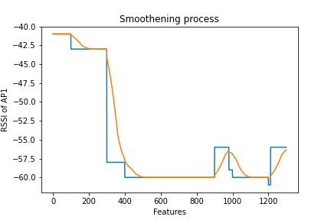
Noisy Data: Smoothing
moving mean
Year | Number of People | Moving Mean (3) | Calculation
1998 | 102
1999 | 80 | 98.3 | {f(1998)+f(1999)+f(2000)}/3
2000 | 113 | 110 | {f(1999)+f(2000)+f(2001)}/3
2001 | 137 | 124 | {f(2000)+f(2001)+f(2002)}/3
2002 | 122 | 107.7 | {f(2001)+f(2002)+f(2003)}/3
2003 | 64 | 93.7 | {f(2002)+f(2003)+f(2004)}/3
2004 | 95
Solution from: SSN_ITU
Github: https://github.com/ITU-AI-ML-in-5G-Challenge/SSN_ITU-ML5G-PS-016

Slide 10
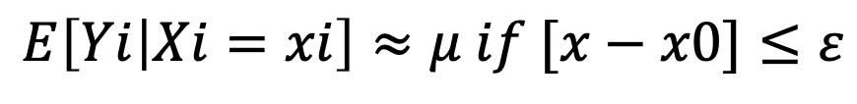
Noisy Data: Smoothing
bin smoothing
Bin smoothing is the idea that f(x) can be considered a constant if f(x) is only changing slightly
So we can assume a value and create a formula so that the value is a constant if it smaller than said value
$$E\left[Yi | Xi=xi\right]≈μ if [x−x0]≤ε$$
Data: [ 8, 9, 15, 16, 21, 21, 24, 26, 27, 30, 30, 34]
Bin 1
Bin 2
Bin 3
μ = 12
μ = 23
μ = 30

Slide 11
Data
Transformation

Slide 12
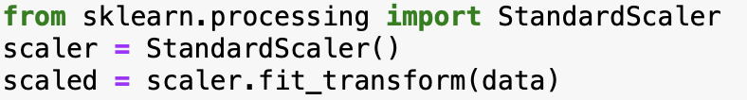
Different Data
Min-max scaler (normalization), standard scaler
Lab encoder (sklearn) to deal with ordinal variables
One hot encoding
Year | Number of People | Price | Profit
1998 | 10200 | $50 | Medium
1999 | 260000 | $32 | High
2000 | 4820 | $12 | Low
2001 | 1000080 | $68 | High
2002 | 1220 | $98 | Medium
2003 | 64500 | $102 | High
2004 | 3180 | $97 | Medium
Year | Number of People | Price | Profit (high:3, medium:2, low:1)
1998 | 10200 | $50 | 2
1999 | 260000 | $32 | 3
2000 | 4820 | $12 | 1
2001 | 1000080 | $68 | 3
2002 | 1220 | $98 | 2
2003 | 64500 | $102 | 3
2004 | 3180 | $97 | 2

Slide 13
Dimentionality
Reduction

Slide 14
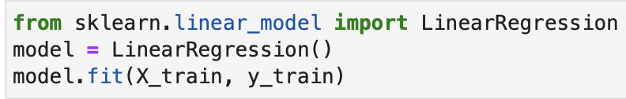
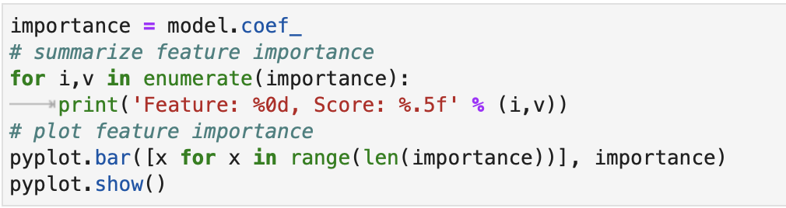
Excessive Data
feature selection
Feature selection is the process of reducing the number of features according to how relevant they are to the output
The simplest method is using correlation coefficients
Correlation coefficients

Slide 15
Advanced
Techniques

Slide 16
Excessive Data
feature selection
XGBoost – eXtreme Gradient Boosting
“a scalable, distributed gradient-boosted decision tree (GBDT) machine learning library”
2020 AI/ML in 5G Challenge
KDDI’s problem statement: Analysis on route information failure in IP core networks by NFV-based test environment

Slide 17
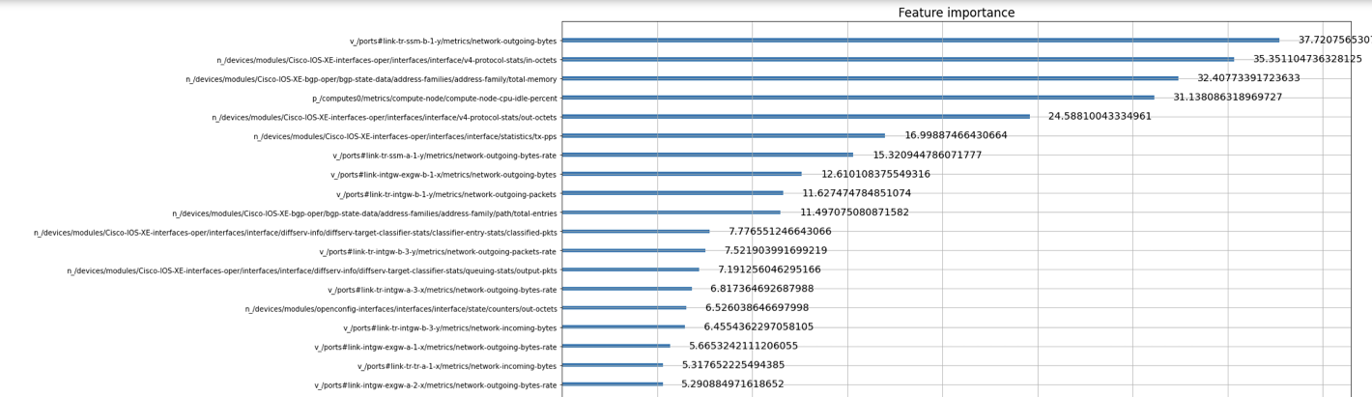
Solution from: UT-NakaoLab-AI Team
Github: https://github.com/ITU-AI-ML-in-5G-Challenge/ITU-ML5G-PS-032-KDDI-UT-NakaoLab-AI
ITU 2021 Journal: https://www.itu.int/dms_pub/itu-s/opb/jnl/S-JNL-VOL2.ISSUE4-2021-A09-PDF-E.pdf

Slide 18
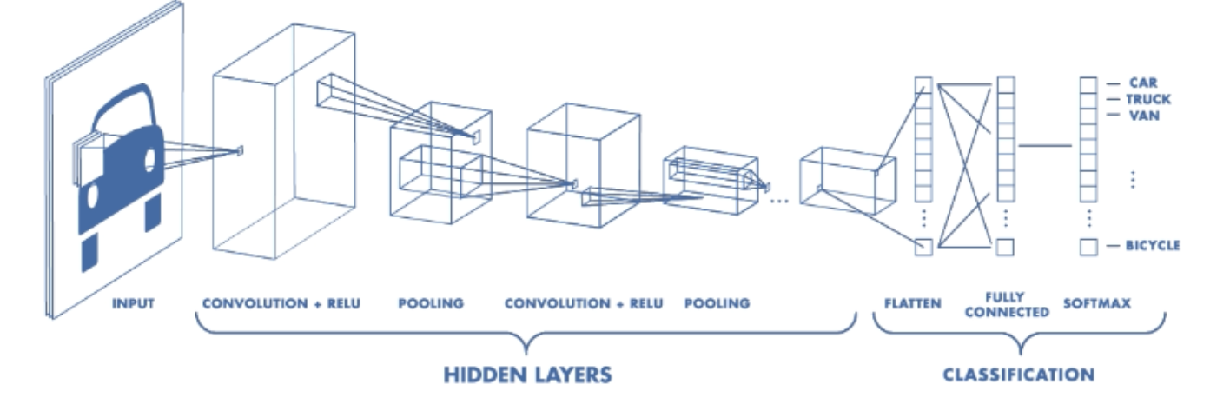
Excessive Data
pooling
Solution from: WirelessAI
Github: https://github.com/ITU-AI-ML-in-5G-Challenge/ITU-ML5G-PS-004-spatial-reuse-team-WirelessAI
Image from: https://www.mathworks.com/videos/introduction-to-deep-learning-what-are-convolutional-neural-networks--1489512765771.html

Slide 19
Excessive Data
max pooling
1 | 1 | 2 | 4
5 | 6 | 7 | 8
3 | 2 | 1 | 0
1 | 2 | 3 | 4
6 | 8
3 | 4

Slide 20
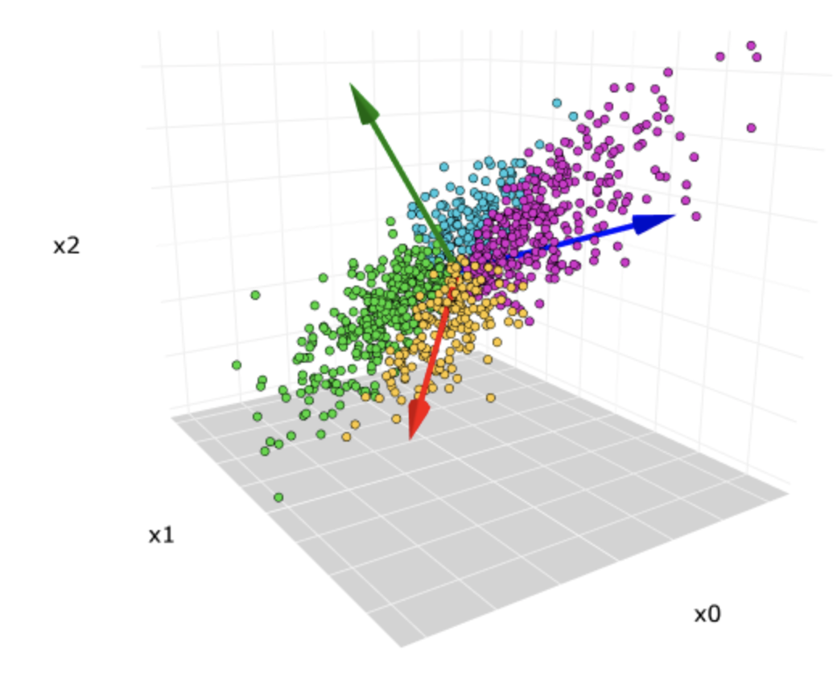
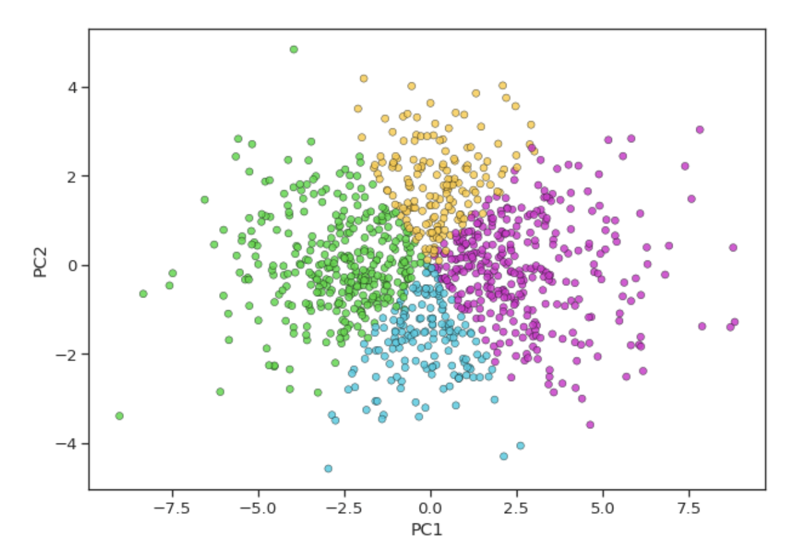
Excessive Data
Principal Component Analysis (PCA)
High Dimension → Low Dimension
Image from: https://towardsdatascience.com/principal-component-analysis-pca-explained-visually-with-zero-math-1cbf392b9e7d

Slide 21
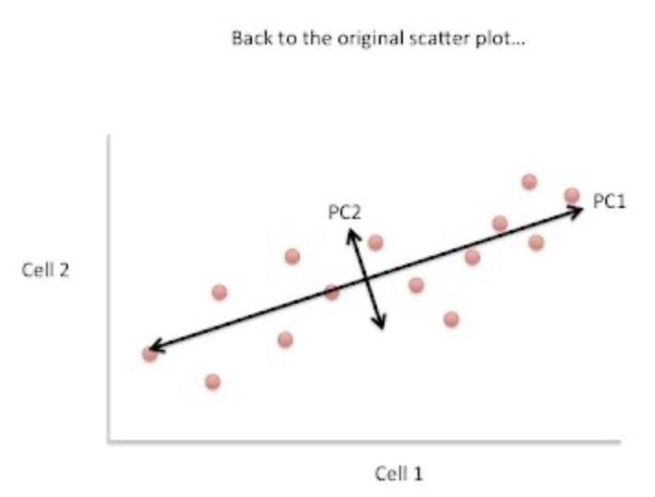
Excessive Data
Principal Component Analysis (PCA)
Standardize the data
Calculate the covariance matrix
Calculate the Eigenvectors and Eigenvalues of the Covariance Matrix
Reduce Dimensionality
Diagram from: https://www.youtube.com/watch?v=_UVHneBUBW0

Slide 22
Q & A

Slide 23
Jupyter Notebook
Practice

